Slide 1


KS2 Maths and English workshop
Monday 10th November 2025
Session 1: 6:00 – 6:20
(Fraction calculating)
Session 2: 6:20 – 6:40
(Fraction calculating)
Session 3: 6:40 – 7:00
(BIDMAS-the order of operations)

Slide 2
KS2 Curriculum
Curriculum calendars can be found on school website:
Mathematics - Walkwood Church of England Middle School

Slide 3
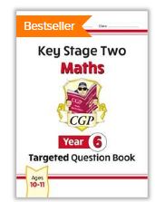

Useful websites and books
Home - MyMaths
CGP
Letts
Collins
WHSmith
Rising Stars

Slide 4
BIDMAS- the order of operations

Slide 5
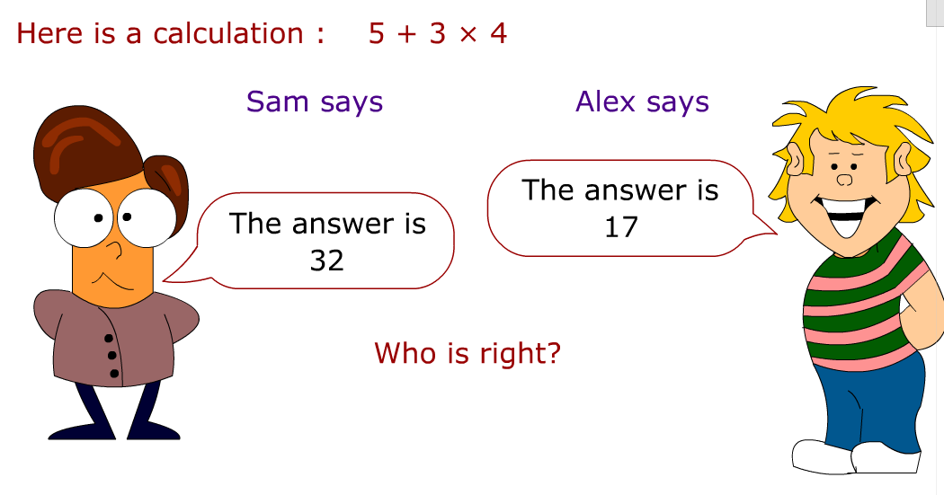

Slide 6
BIDMAS- the order of operations
To help us remember the order we use the word BIDMAS
B
I
D
M
AS
Brackets first
Then Indices (another name for powers e.g. 3²)
Then Division
Then Multiplication
Do adding and subtracting together at the end, going left to right

Slide 7

BIDMAS
24 + 35 ÷ 5
70 – 24 ÷ 6
44 – 5 x 6
5 + (4 x 8)

Slide 8

Indices
5 ²
6² + 10
3³
7² - 2³

Slide 9
Useful lessons in ‘Mymaths.co.uk’
Login- walkwood
Password- multiply
Select Number then powers and roots:
Squares and triangles lesson.
Squares and cubes lesson.

Slide 10
Useful lessons in ‘Mymaths.co.uk’
Login- walkwood
Password- multiply
Select Algebra then Expressions and formulae:
Order of operations.

Slide 11
Questions?

